Slide 1

Eskom Business Analysis and Electricity Consumption Forecast
JUNE 24, 2023
Kau Tom Tsebe

Slide 2

Executive Summary
Overview: Analysis of electricity production trends (2019–2024), focusing on regions, seasonality, and drivers.
Key Findings:
Peak loads during winter.
Gauteng leads production.
January 2024 shows a 1.85% YoY increase.
Recommendations:
Demand-side management.
Energy efficiency initiatives in volatile regions.

Slide 3

Introduction
Purpose: Guide strategic decisions with insights from production trends.
Data Source: Eskom provincial production data (2019–2024).
Methodology: Statistical and time series analysis (SARIMA).
Limitations: Excludes future economic/policy influences.

Slide 4

Statistical Highlights: National average production: 18,369 GWh. Standard deviation highlights wide variation in output, especially in industrial regions. Outliers :Notable outliers emerge in regions with intense industrial activity or unique seasonal conditions
Data Exploration
Visual Insights: Line Plot: Captures national and regional trends over time, with visible peaks in colder months.
Box Plot: Shows production spread across provinces; Gauteng leads, while Limpopo trails.
Histogram: Distribution leans slightly toward higher production zones

Slide 5
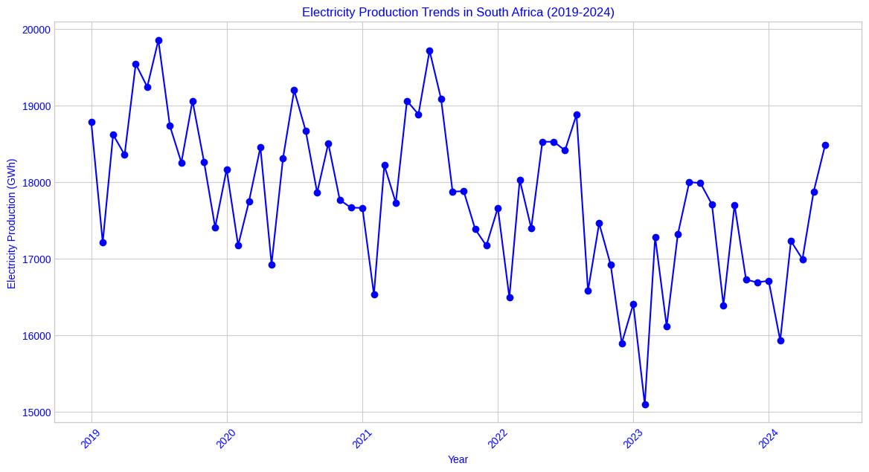
Captures national and regional trends over time, with visible peaks in colder months.

Slide 6
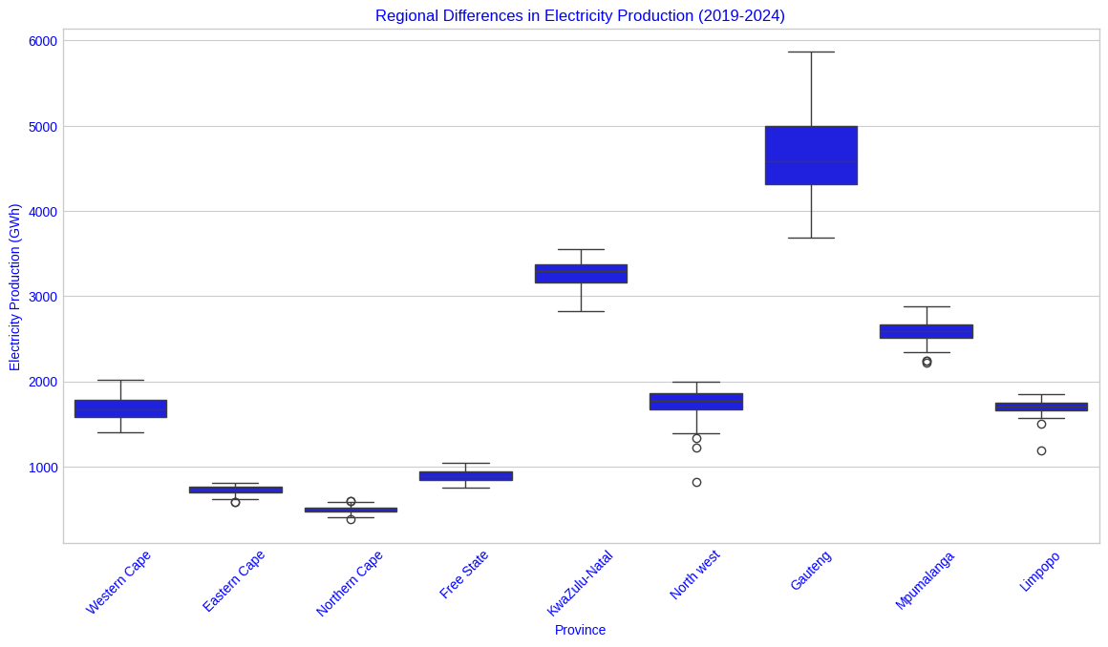
Shows production spread across provinces; Gauteng leads, while Limpopo trails.

Slide 7
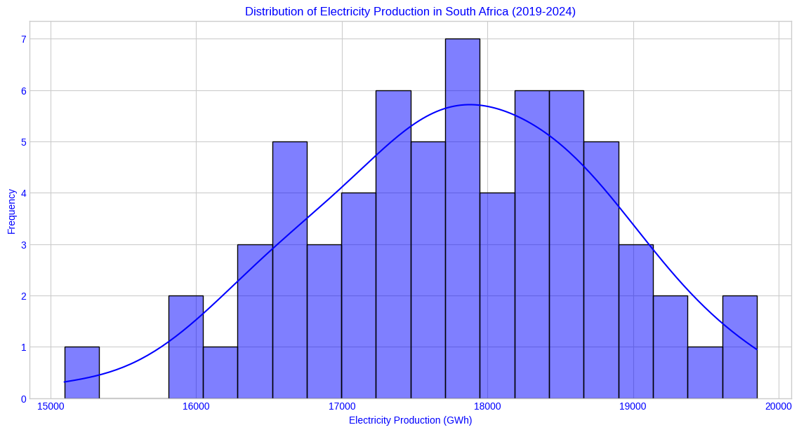
Distribution leans slightly toward higher production zones.

Slide 8
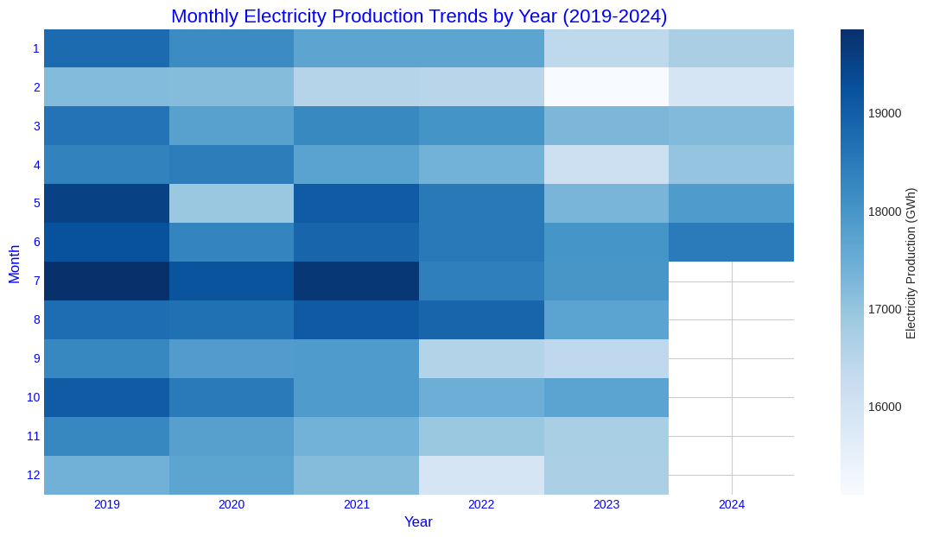
National production is largely stable, though some provinces show upward movement. Winter demand peaks highlight the need for load balancing strategies. Regional differences: Gauteng and KwaZulu-Natal consistently show higher output due to population and industry. Northern Cape and Limpopo lag, often due to sparse population and lower demand.
Trends and Patterns

Slide 9

Consumption Drivers
Peak Load Analysis
Peak loads mainly occur in July and August, influenced by cold fronts.
Weather and economic activity play key roles in determining peak periods.
Suggested strategies:
Time-of-use pricing to shift consumption.
Distributed energy solutions to absorb peak demand, especially in urban centers.
Industrial usage is the largest consumption driver in regions like Gauteng.
Residential demand rises during winter months, especially in urban areas.
Correlation between production and economic indicators like GDP suggests economic growth is a major factor.
Higher population density correlates positively with consumption.

Slide 10
Efficiency and Usage
Peak loads mainly occur in July and August, influenced by cold fronts.
Weather and economic activity play key roles in determining peak periods.
Suggested strategies:
Time-of-use pricing to shift consumption.
Distributed energy solutions to absorb peak demand, especially in urban centers.

Slide 11
Business Recommendations
Cost optimization:
Implement differentiated pricing models for off-peak/peak hours.
Reduce operational costs by using predictive analytics for load management.
Sustainability goals:
Gradually increase the share of renewables.
Invest in public awareness campaigns for responsible energy use.
Capacity planning:
Upgrade grids in growth regions.
Establish smart meters for better tracking and control.

Slide 12

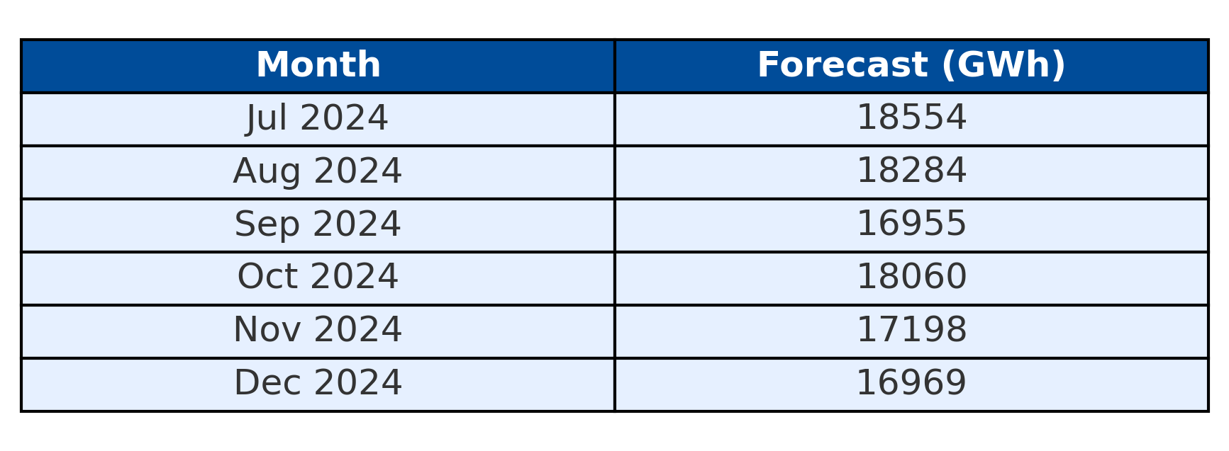
Forecast (SARIMA Predictions)
The SARIMA model predicts a gradual decline in consumption heading into December, consistent with reduced heating needs.

Slide 13
Forecast Implications
Seasonal Decline: As temperatures rise, energy demand falls – Eskom should plan for lower generation and allocate maintenance during this period.
Monthly Variability: Spikes and dips suggest economic and industrial fluctuations. Flexibility is key in operational planning.
Strategic Adjustments:
Use forecast data to optimize energy dispatch.
Adjust tariff models seasonally.
Reliability Caveats: Forecasting is useful, but Eskom must monitor real-time data to adapt to weather shocks and economic changes.

Slide 14
Conclusion
South Africa’s electricity landscape is shaped by seasonal patterns, industrial drivers, and regional disparities.
Opportunities exist to:
Reduce demand during peak seasons.
Improve energy efficiency across provinces.
Embrace renewable technologies to future-proof the grid.
Future research should explore:
The effect of smart grid technology.
Influence of energy policy on long-term production.

Slide 15

Conclusion
Link to raw data and code:
https://drive.google.com/drive/folders/1yfvIVvsosjqRiD7XcziickFwqDJlg3Hw?usp=sharing
Source: https://www.statssa.gov.za/?page_id=1854&PPN=P4141&SCH=73631
By
Tom Tsebe Kau

